Slide 1

Domain Hosting Register Full Process
By Programmer Lab.com
By Codewithashim

Slide 2

First go web browser , then search a domain hosting provider name (we use namechip web hosting provider )

Slide 3
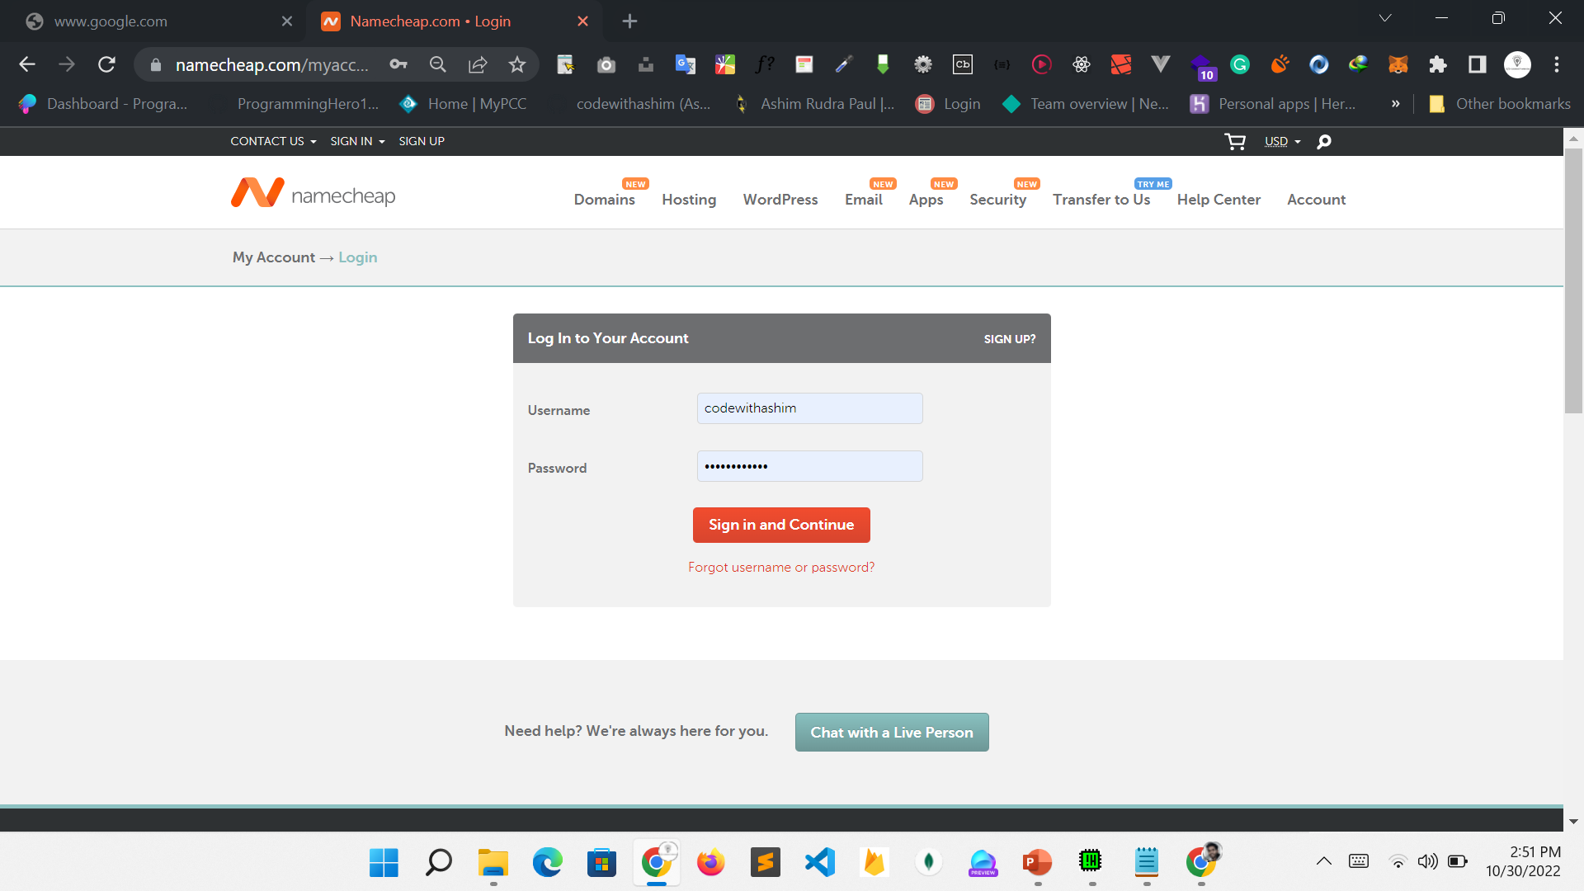

Slide 4
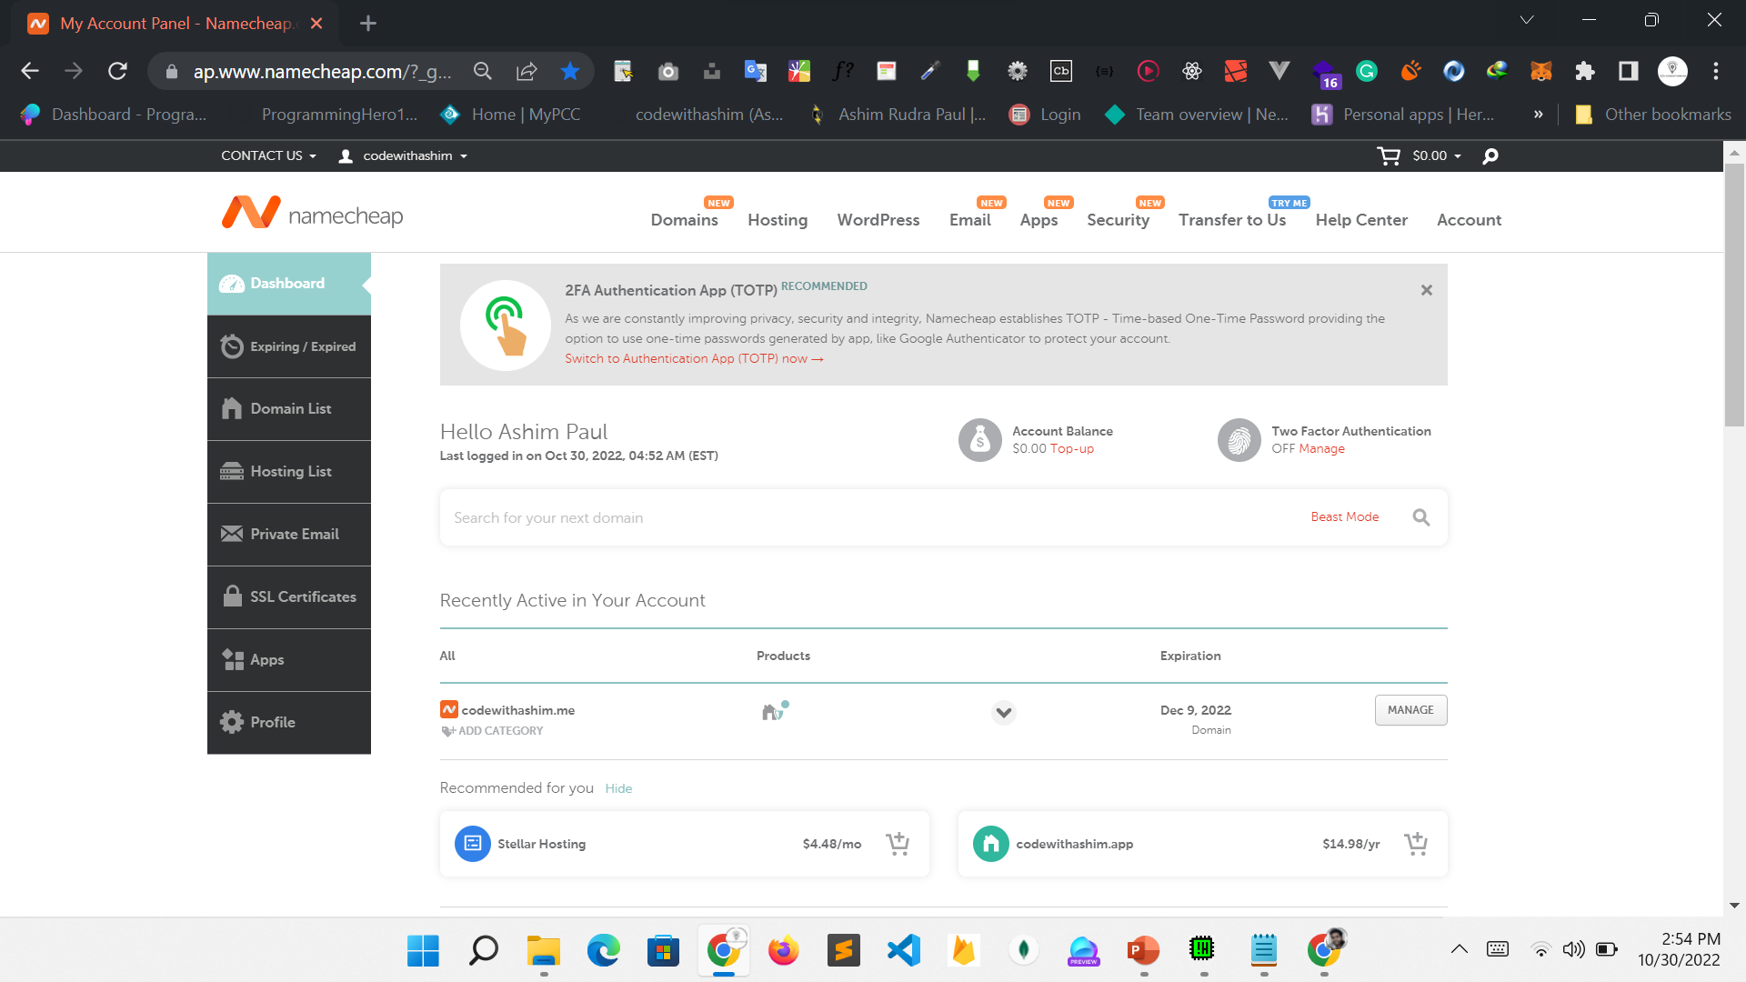

Slide 5
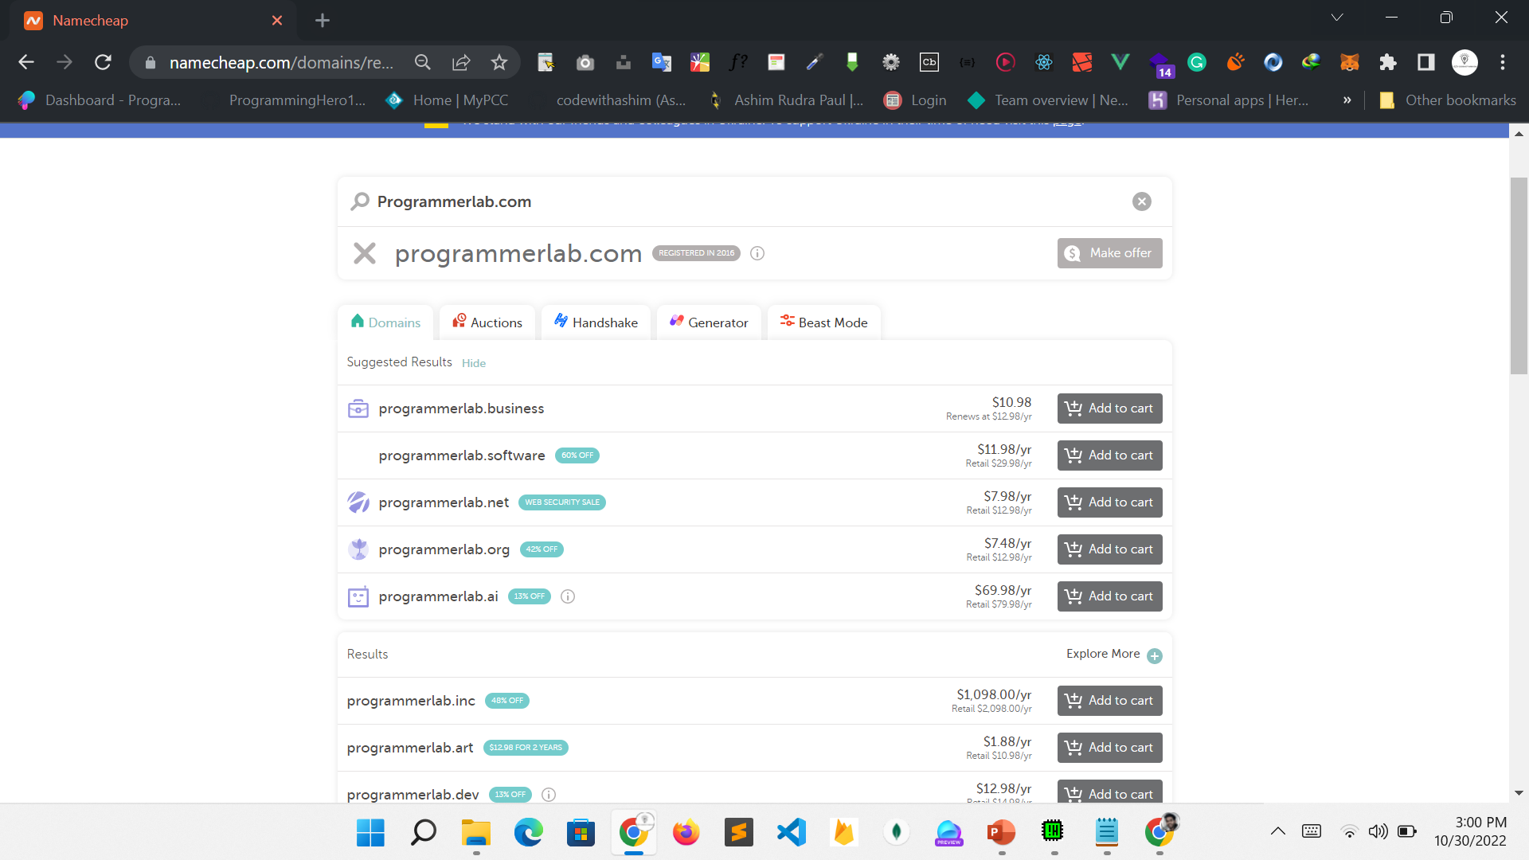

Slide 6
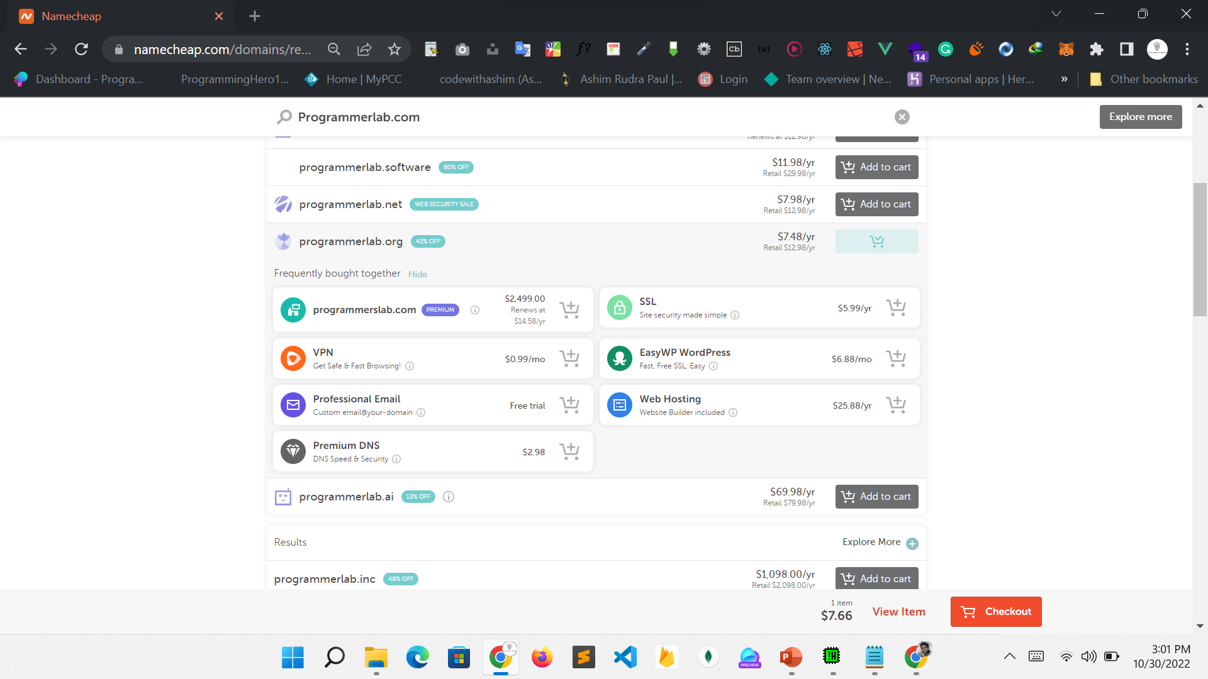

Slide 7
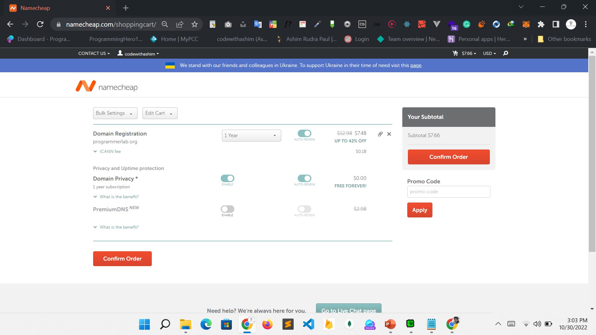

Slide 8
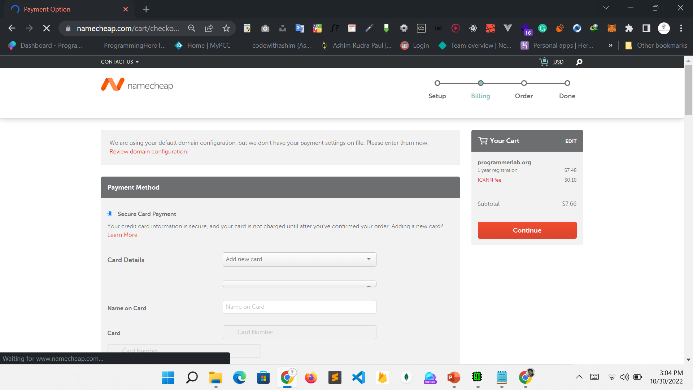

Slide 9
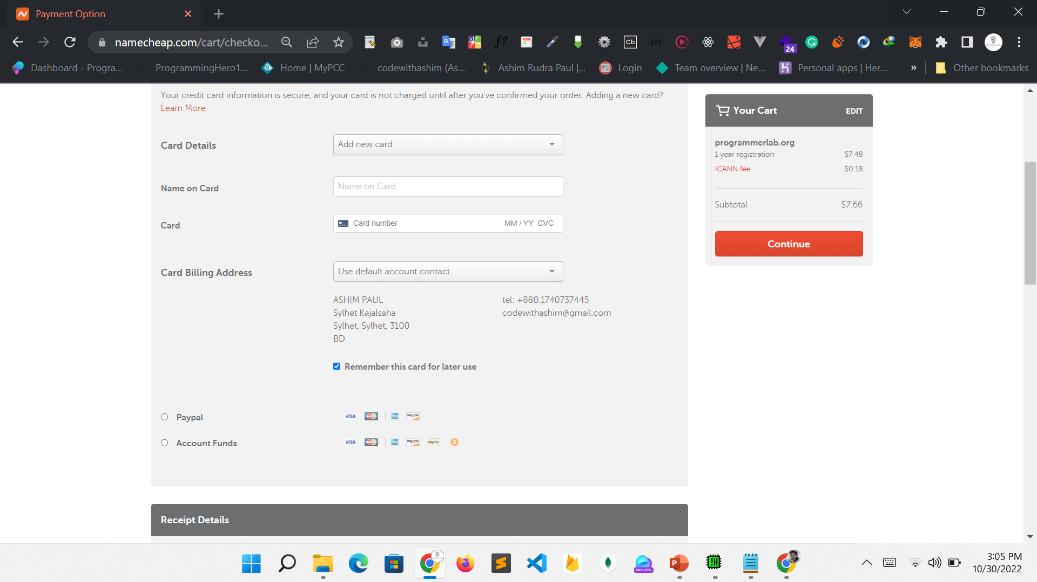

Slide 10
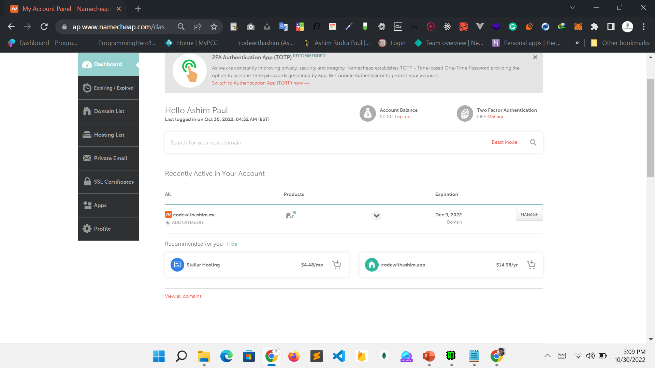

Slide 11
